Slide 1

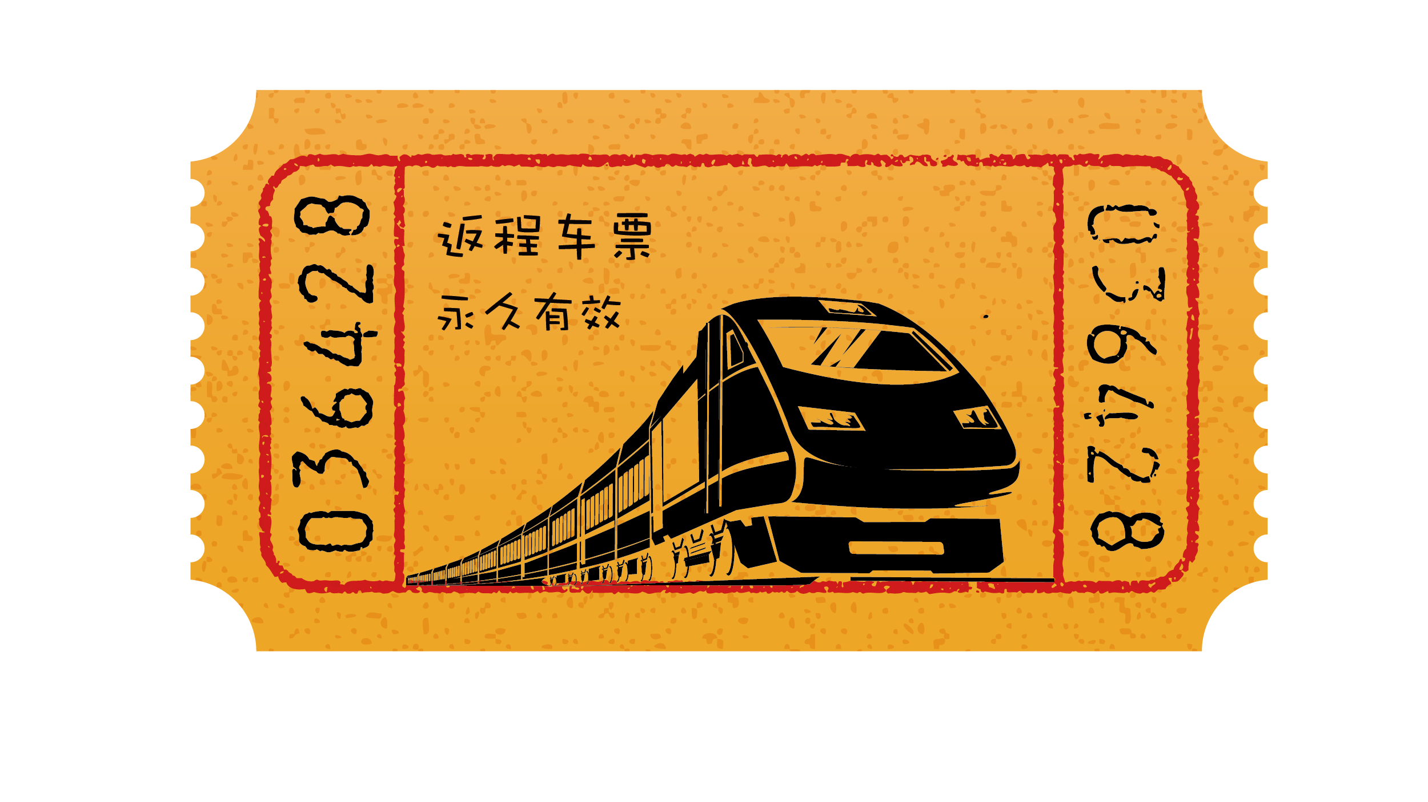
TRAIN TICKET PRICE PREDICTION

Slide 2




TEAM 11
Lalitha Sravani Gannavarapu
Data Analyst
Bhavana Yelisetti
Machine Learning Engineer
Apurva Ravikar
Data Preprocessor
Kavita Madiraju
Data Engineer

Slide 3

INTRODUCTION
In today's ever-changing transportation landscape, accurately predicting train ticket prices is vital for providing efficient and cost-effective travel solutions. The complexity of factors such as demand and varied routes poses challenges for traditional pricing models. A successful prediction model ensures fair pricing for passengers, allowing railway companies to optimize revenue and enhance overall service quality.

Slide 4

Challenge
How to predict the price of Train ticket based on certain features?
Train ticket prices are influenced by a multitude of factors, making them a complex and dynamic pricing challenge. However, with the power of data and machine learning, we aim to create models that provide accurate fare predictions. Challenges in this endeavor include handling the variability in demand, accounting for different travel classes and routes, and adapting to changing market dynamics. As the industry evolves, these models can play a pivotal role in optimizing pricing strategies for the benefit of both consumers and railways

Slide 5

Solution
Predicting train ticket prices requires a well-planned approach that incorporates data collection, transformation, feature engineering, model building, and deployment. Our solution focuses on predicting train ticket prices by analyzing key dataset columns including origin, destination, train type, price, train class, fare, and travel time. By leveraging advanced machine learning techniques and AWS infrastructure, we aim to accurately forecast ticket prices, enabling our railway company to optimize pricing strategies and enhance revenue generation effectively.

Slide 6
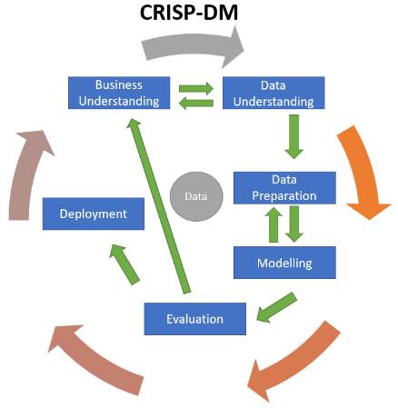
USER STORY
User Story
As a User, I should be able to book a train ticket that meets all my requirements
Sub Goal
take in the specifications of the customer and process them to find the solution that meets all or maximum of the specifications
Business Goal
Main Goal
To suggest a train ticket to the customer
Product

Slide 7
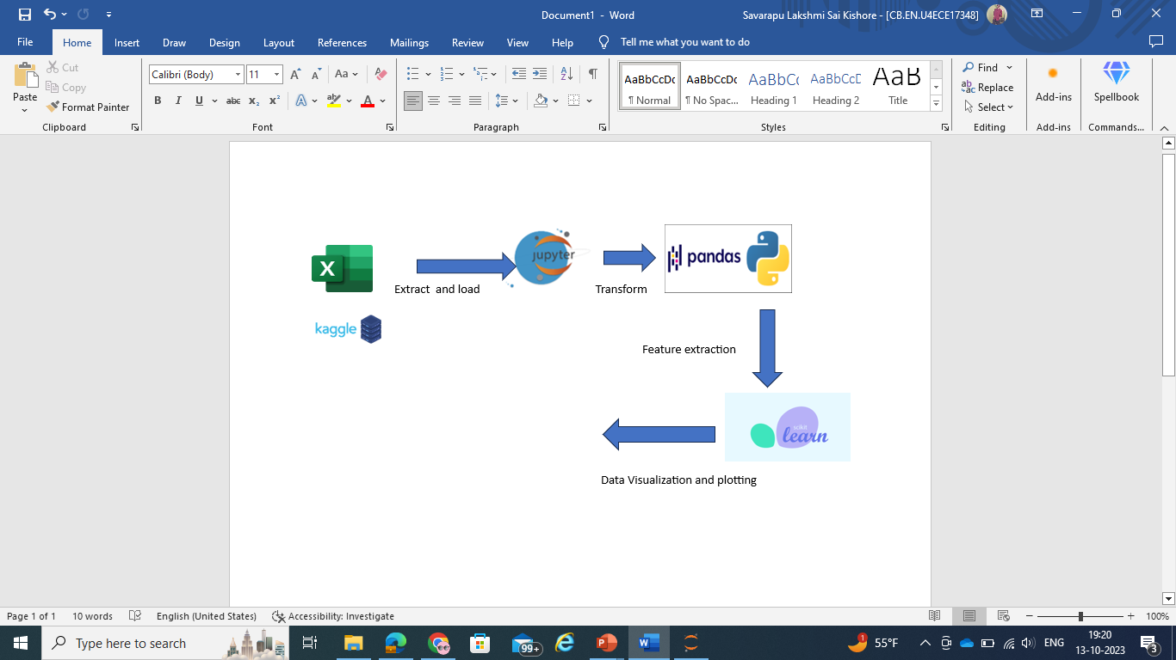



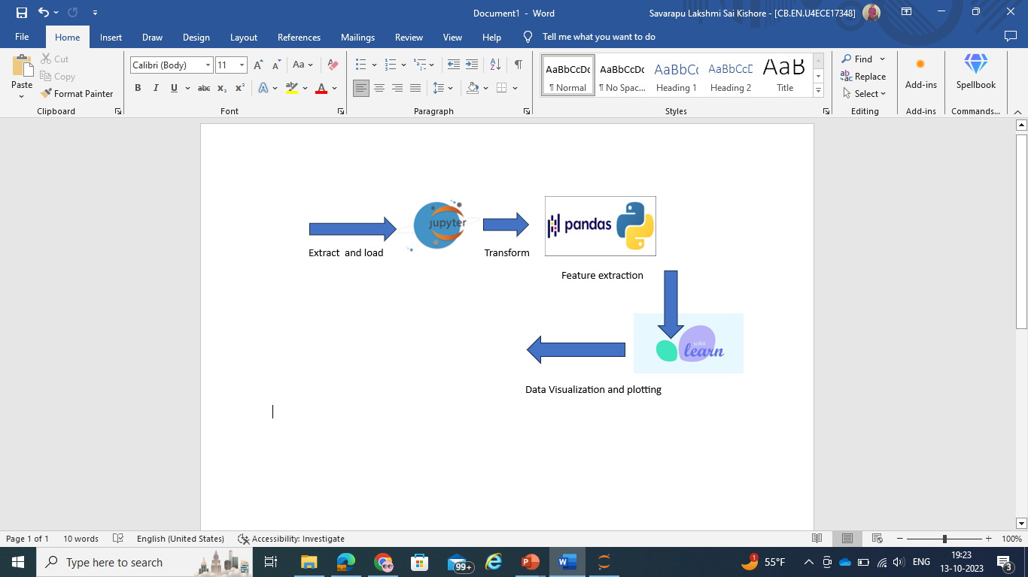
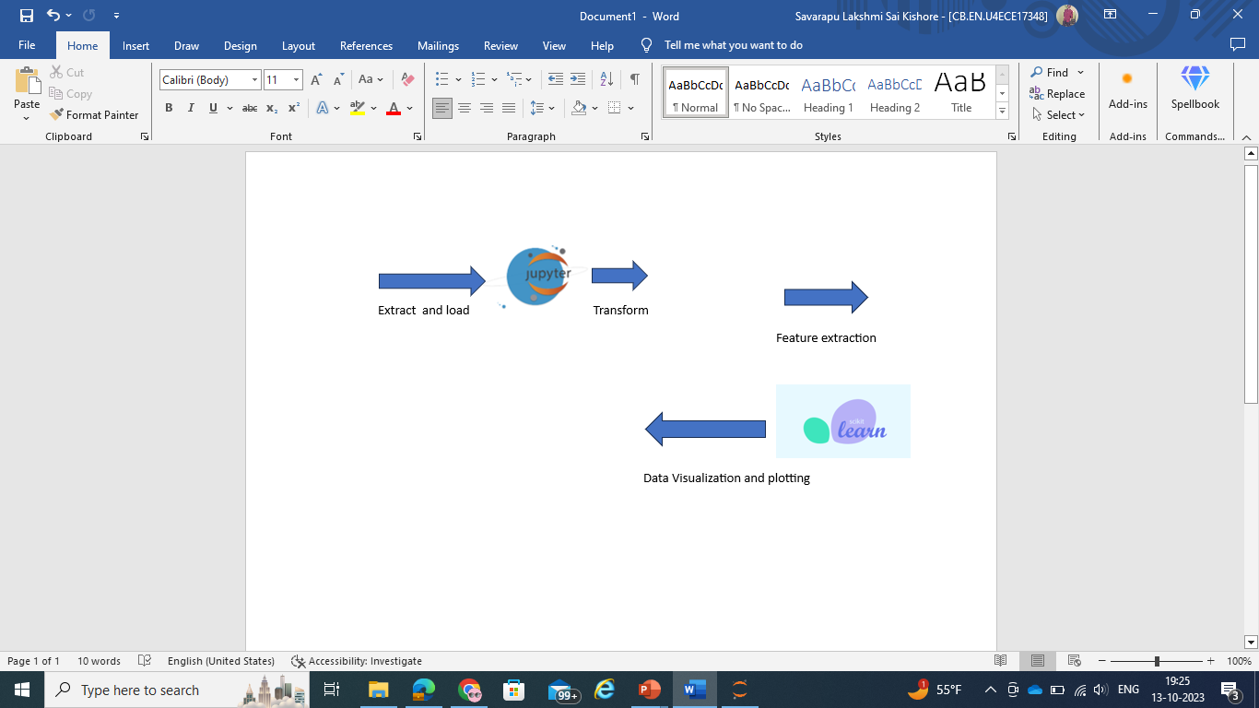
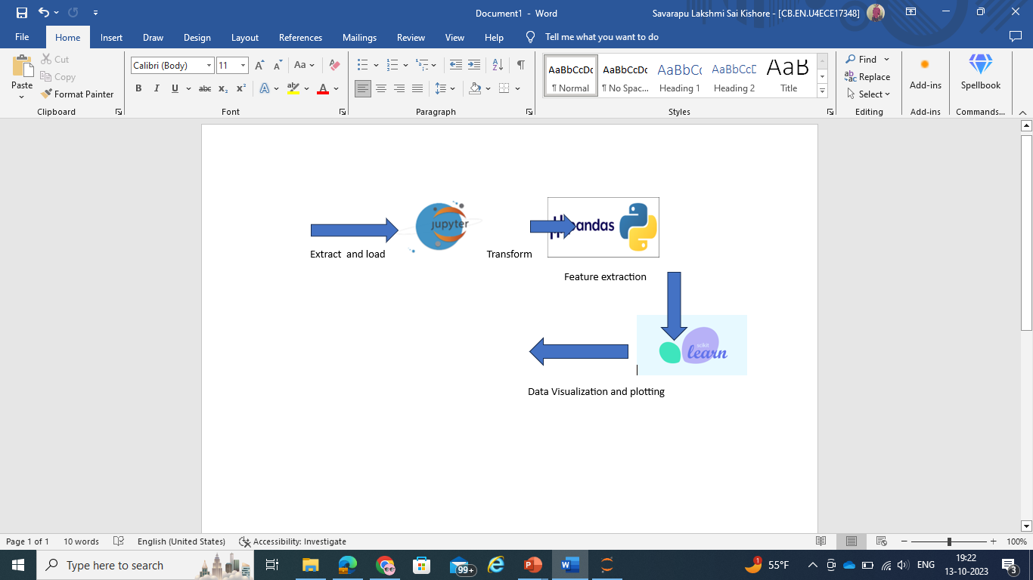
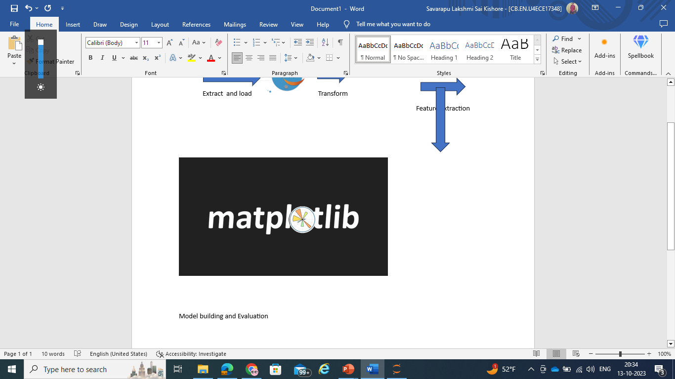


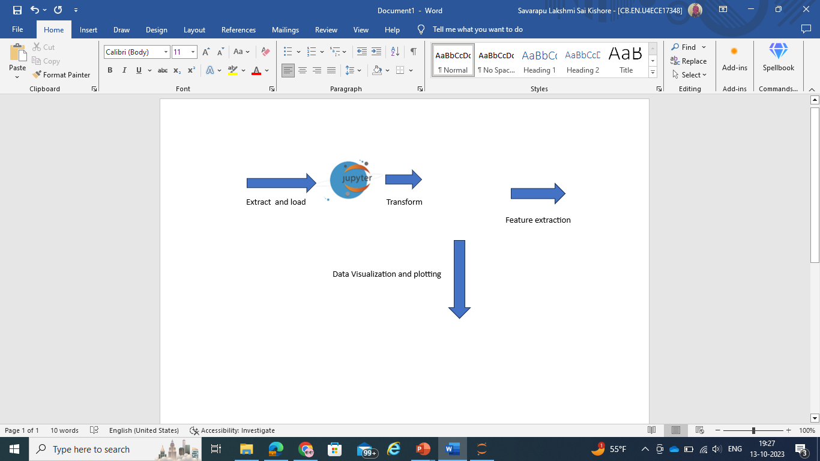

GRAPHICAL VIEW OF THE Proposed MODEL

Slide 8
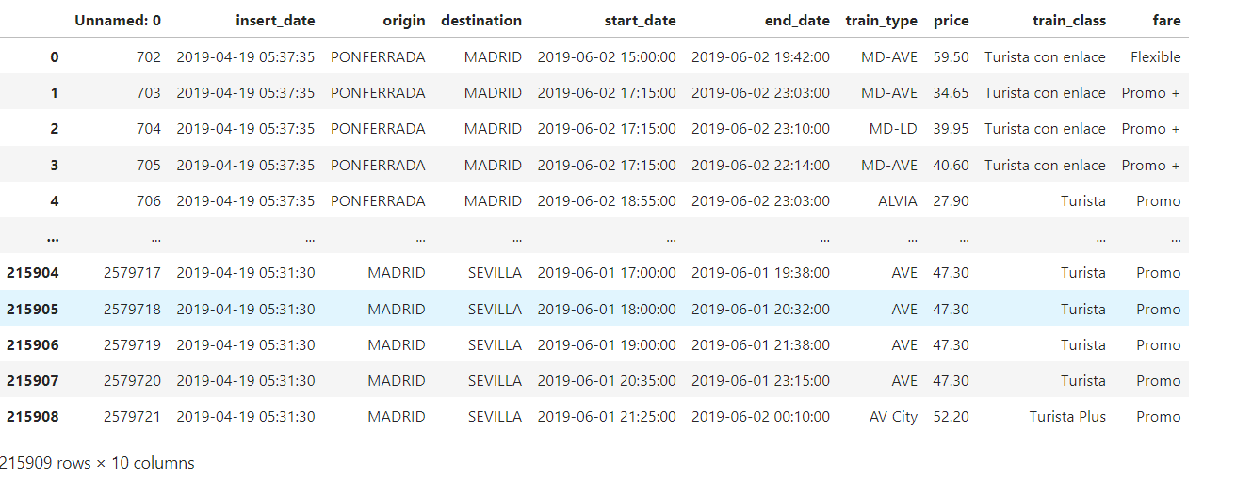
Dataset from Kaggle
https://www.kaggle.com/code/umairaslam/train-ticket-price-prediction-project/input
Volume: 215909 samples of data
Variety: Structured Data
Velocity: Data generated during the pre covid period
Veracity: Kaggle is said to be the trusted go to point of information
Value: Data can be used to estimate domestic train ticket prices in Spain

Slide 9
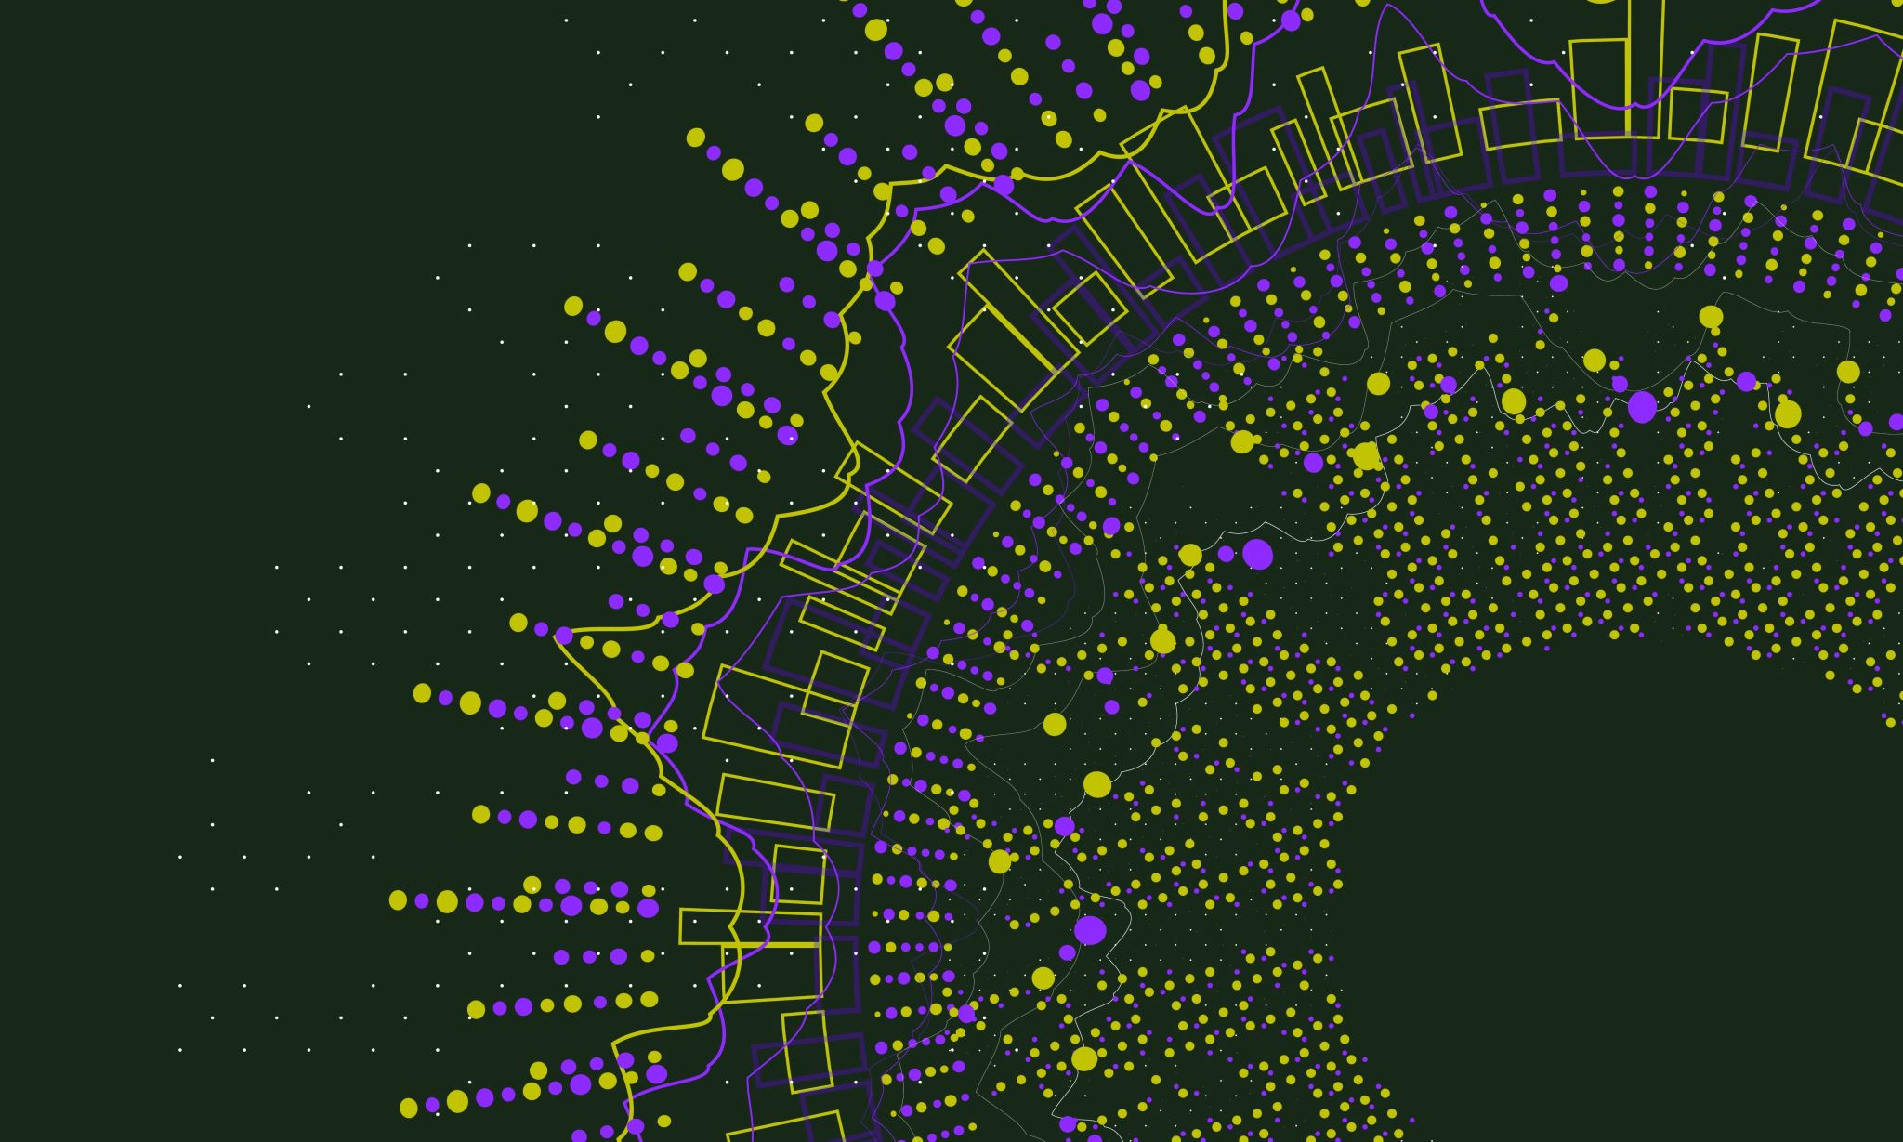
Tools to be used
Data is collected from Kaggle.and stored in S3 for usage and access.
Used tools like the AWS CLI and AWS Management Console to upload data to S3.(Data Ingestion).
Amazon Glue is used for a fully managed ETL (Extract, Transform, Load) service for transforming and processing data. (Data Processing).
Load data from S3 into SageMaker, train the model, evaluate with common metrics, and save to S3 for deployment.(Data Consumption).
Used Seaborn in a Jupyter notebook to visualize data and model results
Deploy the trained model to a SageMaker endpoint.

Slide 10
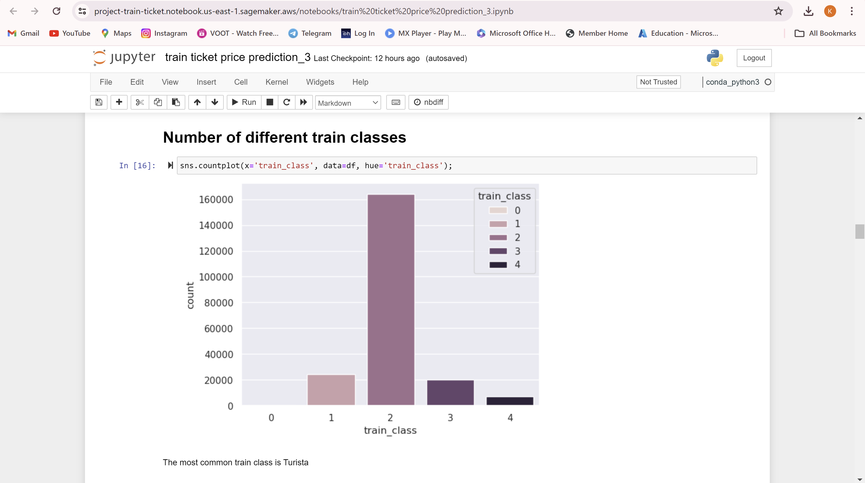
Analysis

Slide 11
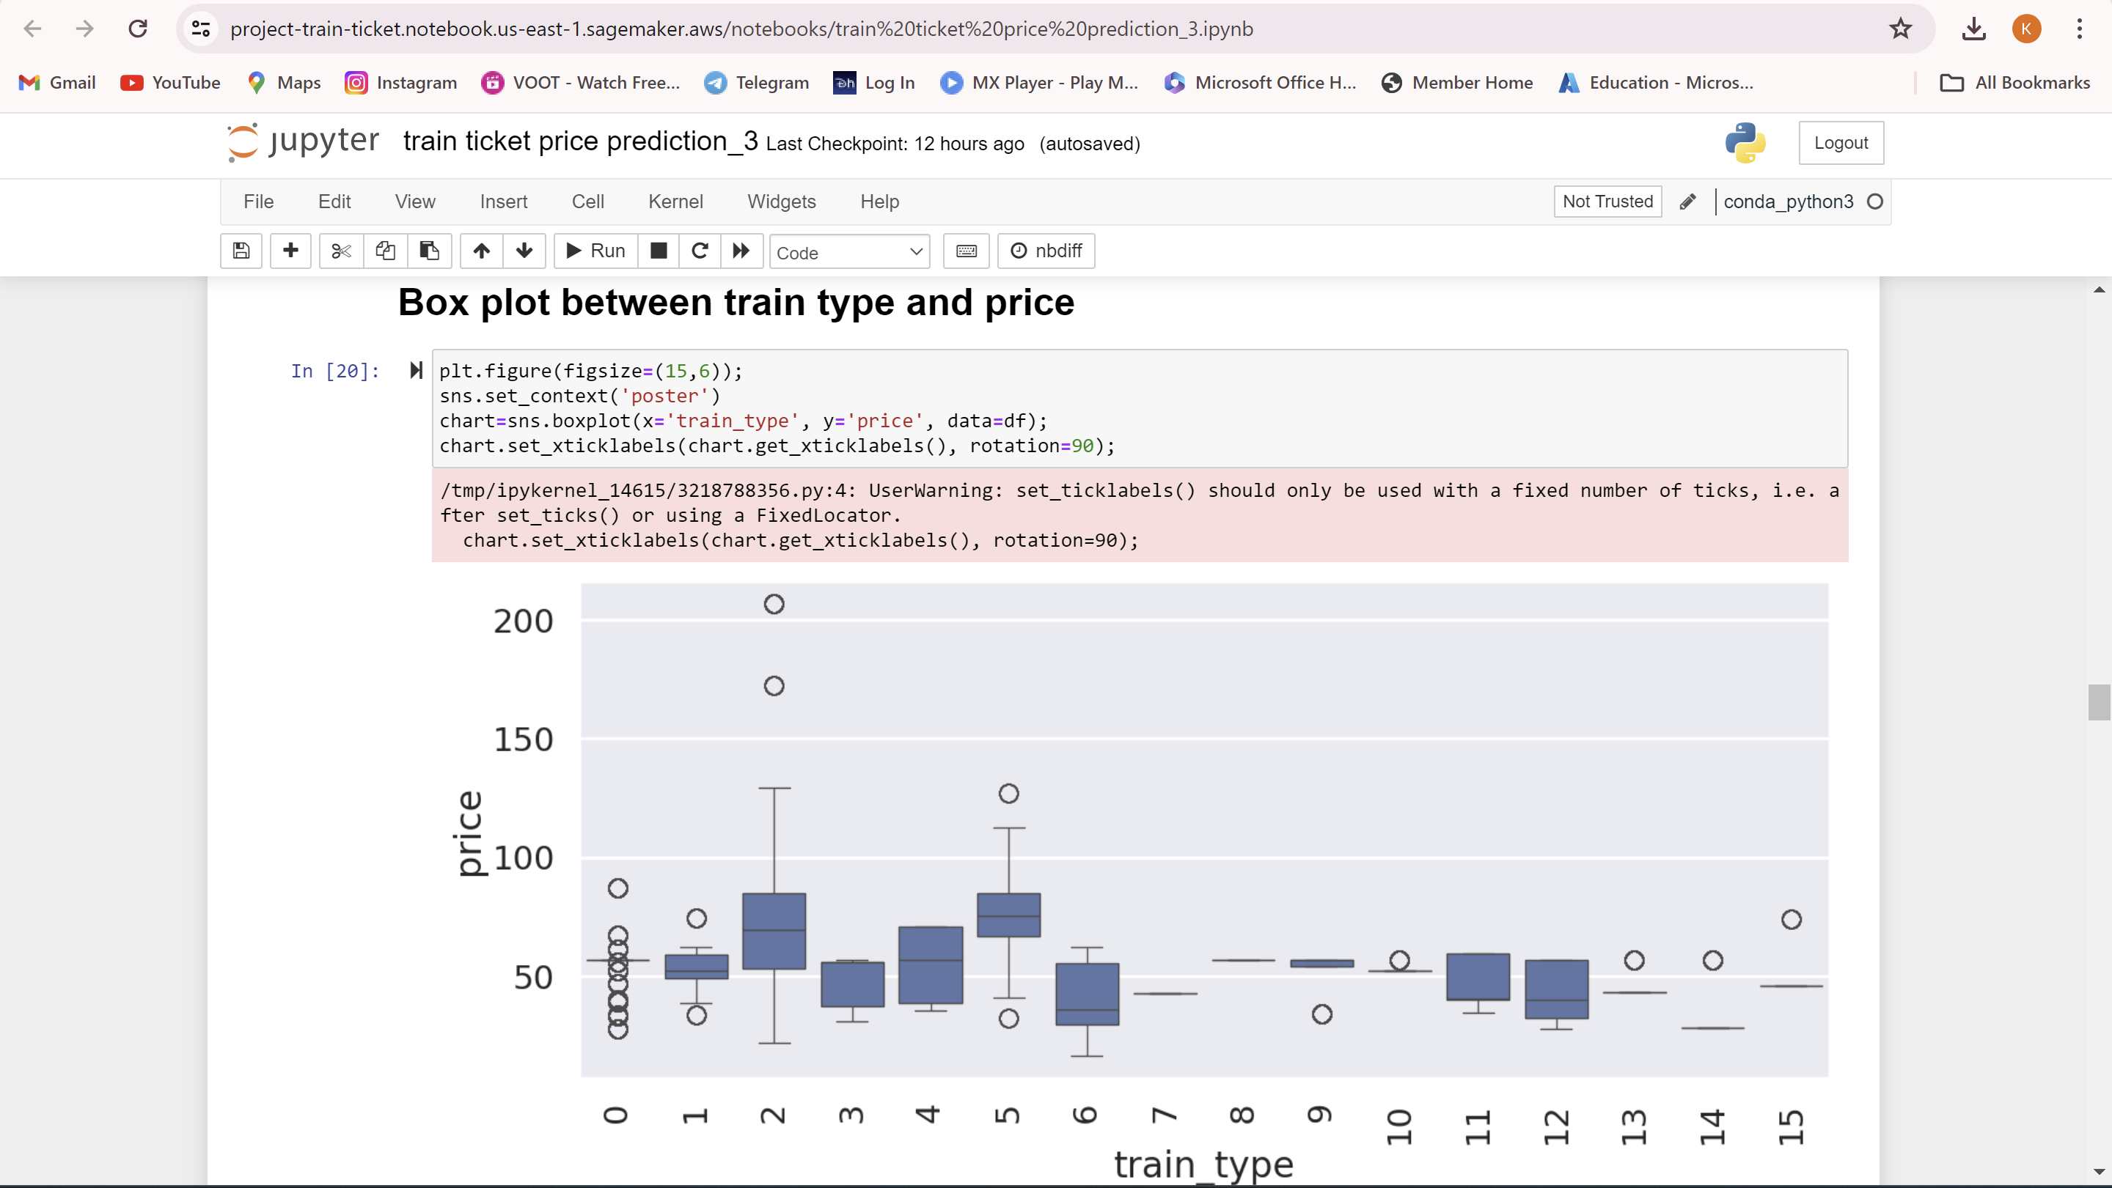
ANALYSIS

Slide 12

MODELS TO BE USED
Linear learner: Utilized for its simplicity and interpretability, although yielding a mean squared error (MSE) of 164.69, indicating moderate predictive accuracy.
Random Forest Regressor: Selected for its ability to capture complex relationships in the data, resulting in a significantly lower MSE of 72.02 compared to linear regression, signifying improved predictive performance.

Slide 13
Challenges Faced
Feature Engineering
Handling demand fluctuations
Route Complexity
Model selection

Slide 14
GITHUB
LINK : https://github.com/gannavarapu-lalitha-sravani/Train-Ticket-Price-Prediction.git

Slide 15
references
https://youtu.be/WjLou_0YVMo?si=O_MsRoI5q4ooTXeC
https://youtu.be/46bRwRvW0PI?si=KIchjcJvDOZkfBMq
https://youtu.be/KFPX0FLhscs?si=VSFVpvoKYssh3epv

Slide 16
Thank You and Have a Safe Train!

